Slide 1

Guide to Programming with Python
Chapter Nine (Part 1)
Object-Oriented Programming, Inheritance, Modules: The Blackjack Game

Slide 2
Objectives
Create objects of different classes in the same program
Allow objects to communicate with each other
Create more complex objects by combining simpler ones
Derive new classes from existing ones
Extend the definition of existing classes
Override method definitions of existing classes
Guide to Programming with Python

Slide 3
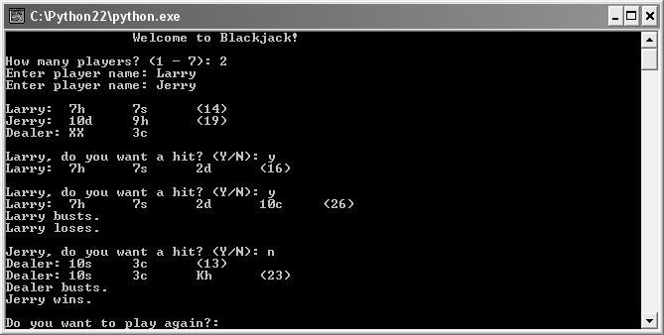
The Blackjack Game
Figure 9.1: Sample run of the Blackjack game
One player wins, the other is not so lucky.
Guide to Programming with Python

Slide 4
Sending and Receiving Messages
Object-oriented program like an ecosystem
Objects like organisms
Organisms interact and so do objects
Message: Communication between objects; one object sends another a message when it invokes a method of the other
Guide to Programming with Python

Slide 5
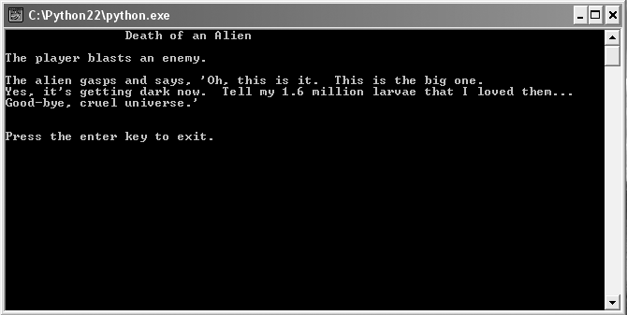
The Alien Blaster Program
Figure 9.2: Sample run of the Alien Blaster program
Battle description is result of objects exchanging message.
Guide to Programming with Python

Slide 6
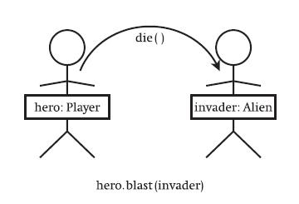
The Alien Blaster Program (continued)
Figure 9.3: Visual representation of objects exchanging a message
hero (a Player object) sends invader (an Alien object) a message.
invader.die()
Guide to Programming with Python

Slide 7
The Alien Blaster Program (continued)
class Player(object):
def blast(self, enemy):
print "The player blasts an enemy."
enemy.die()
class Alien(object):
def die(self):
print "Good-bye, cruel universe."
hero = Player()
invader = Alien()
hero.blast(invader)
Guide to Programming with Python

Slide 8

Sending a Message
class Player(object):
def blast(self, enemy):
print "The player blasts an enemy."
enemy.die()
...
hero.blast(invader)
hero.blast() method is passed invader; i.e.,
the Player blast() method is passed an Alien object
In blast(), enemy refers to the Alien object (invader)
blast() invokes the Alien object’s die() method; i.e., the Player object sends the Alien object a message telling it to die
Guide to Programming with Python
alien_blaster.py

Slide 9
Combining Objects
Real-world objects are often made up of other objects
Can mimic composition and collection in OOP
Drag racer composed of body, tires, and engine
  Drag_Racer class with attribute engine that is a Race_Engine object
Zoo is collection of animals
  Zoo class that has an attribute animals which is a list of different Animal objects
Guide to Programming with Python

Slide 10
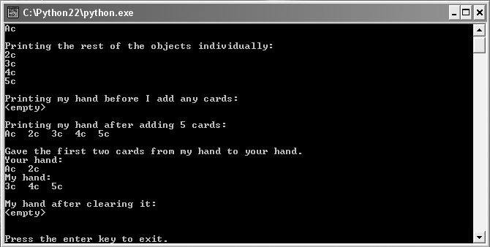
The Playing Cards Program
Figure 9.4: Sample run of the Playing Cards program
Each Hand object has a collection of Card objects.
Guide to Programming with Python

Slide 11
Creating the Card Class
class Card(object):
""" A playing card. """
RANKS = ["A", "2", "3", "4", "5", "6", "7",
"8", "9", "10", "J", "Q", "K"]
SUITS = ["c", "d", "h", "s"]
def __init__(self, rank, suit):
self.rank = rank
self.suit = suit
def __str__(self):
reply = self.rank + self.suit
return reply
Guide to Programming with Python

Slide 12
Creating the Card Class (continued)
Card object’s rank attribute represents rank of card
  RANKS class attribute has all possible values
  "A" ace, "J" jack, "Q" queen, "K" king, "2" - "10" numeric values
Card object’s suit attribute represents suit of card
  SUITS class attribute has all possible values
  "c" clubs, "d" diamonds, "h" hearts, "s" spades
A Card object with rank "A" and suit "d" is the ace of diamonds
Guide to Programming with Python

Slide 13
Creating the Hand Class
class Hand(object):
""" A hand of playing cards. """
def __init__(self):
# Keep track of the cards in this hand
self.cards = []
def __str__(self):
# Return a string representing the hand
if self.cards:
reply = ""
for card in self.cards:
reply += str(card) + " "
else:
reply = "<empty>"
return reply
Guide to Programming with Python

Slide 14
Creating the Hand Class (continued)
def clear(self):
# Reset to an empty hand
self.cards = []
def add(self, card):
# Add the specified card to this hand
self.cards.append(card)
def give(self, card, other_hand):
# Remove the specified card from this hand
# and add it to a different hand
self.cards.remove(card)
other_hand.add(card)
Guide to Programming with Python

Slide 15
Creating the Hand Class (continued)
Attribute
  cards is list of Card objects
Methods
  __str__() returns string for entire hand
  clear() clears list of cards
  add() adds card to list of cards
  give() removes card from current hand and adds to another hand
Guide to Programming with Python

Slide 16
Using Card Objects
card1 = Card(rank = "A", suit = "c")
card2 = Card(rank = "2", suit = "c")
card3 = Card(rank = "3", suit = "c")
card4 = Card(rank = "4", suit = "c")
card5 = Card(rank = "5", suit = "c")
print card1 # Ac
print card2 # 2c
print card3 # 3c
print card4 # 4c
print card5 # 5c
Guide to Programming with Python

Slide 17
Combining Card Objects Using a Hand Object
my_hand = Hand()
print my_hand # <empty>
my_hand.add(card1)
my_hand.add(card2)
my_hand.add(card3)
my_hand.add(card4)
my_hand.add(card5)
print my_hand # Ac 2c 3c 4c 5c
Guide to Programming with Python

Slide 18
Combining Card Objects Using a Hand Object (continued)
your_hand = Hand()
my_hand.give(card1, your_hand)
my_hand.give(card2, your_hand)
print your_hand # Ac 2c
print my_hand # 3c 4c 5c
my_hand.clear()
print my_hand # <empty>
playing_cards.py
Guide to Programming with Python

Slide 19
Using Inheritance to Create New Classes
Inheritance: An element of OOP that allows a new class to be based on an existing one where the new automatically gets (or inherits) all of the methods and attributes of the existing class
Like getting all the work that went into the existing class for free
Guide to Programming with Python

Slide 20
Extending a Class Through Inheritance
Inheritance is used to create a more specialized version of an existing class
The new class gets all the methods and attributes of the existing class
The new class can also define additional methods and attributes
Drag_Racer class with methods stop() and go()
Clean_Drag_Racer based on Drag_Racer()
  Automatically inherits stop() and go()
  Can define new method, clean(), for cleaning windshield
Guide to Programming with Python

Slide 21
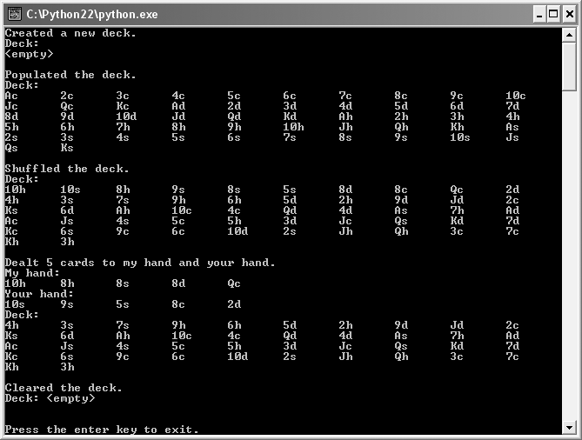
The Playing Cards 2.0 Program
Figure 9.5: Sample run of the Playing Cards 2.0 program
The Deck object inherits all of the methods of the Hand class.
Guide to Programming with Python

Slide 22
Creating a Base Class
(Same as before)
class Hand(object):
""" A hand of playing cards. """
def __init__(self):
self.cards = []
def __str__(self):
if self.cards:
reply = ""
for card in self.cards:
reply += str(card) + " "
else:
reply = "<empty>"
return rep
Guide to Programming with Python

Slide 23
Creating a Base Class (continued)
(Same as before)
def clear(self):
self.cards = []
def add(self, card):
self.cards.append(card)
def give(self, card, other_hand):
self.cards.remove(card)
other_hand.add(card)
Guide to Programming with Python

Slide 24
Inheriting from a Base Class
class Deck(Hand):
Base class: A class upon which another is based; it is inherited from by a derived class
Derived class: A class that is based upon another class; it inherits from a base class
Hand is base class
Deck is derived class
Guide to Programming with Python

Slide 25
Inheriting from a Base Class (continued)
Deck inherits Hand attribute:
  cards
Deck inherits all Hand methods:
  __init__()
  __str__()
  clear()
  add()
  give()
Guide to Programming with Python

Slide 26
Extending a Derived Class
class Deck(Hand):
""" A deck of playing cards. """
def populate(self):
for suit in Card.SUITS:
for rank in Card.RANKS:
self.add(Card(rank, suit))
def shuffle(self):
import random
random.shuffle(self.cards)
Guide to Programming with Python

Slide 27
Extending a Derived Class (continued)
def deal(self, hands, per_hand = 1):
for rounds in range(per_hand):
for hand in hands:
if self.cards: # if len(self.cards) > 0
top_card = self.cards[0]
self.give(top_card, hand)
else:
print "Out of cards!"
Guide to Programming with Python

Slide 28
Extending a Derived Class (continued)
In addition to methods Deck inherits, it defines new methods:
  populate()
  shuffle()
  deal()
Guide to Programming with Python

Slide 29
Using the Derived Class
deck1 = Deck()
print deck1 # <empty>
deck1.populate()
print deck1 # ordered deck
deck1.shuffle()
print deck1 # shuffled deck
Guide to Programming with Python

Slide 30
Using the Derived Class (continued)
my_hand = Hand()
your_hand = Hand()
hands = [my_hand, your_hand]
deck1.deal(hands, per_hand = 5)
print my_hand # 5 alternating cards from deck
print your_hand # 5 alternating cards from deck
print deck1 # deck minus first 10 cards
deck1.clear()
print deck1 # <empty>
playing_cards2.py
Guide to Programming with Python

Slide 31
Guide to Programming with Python
Chapter Nine (Part 2)
Object-Oriented Programming, Inheritance, Modules: The Blackjack Game

Slide 32
Altering the Behavior of Inherited Methods
Override: To redefine how inherited method of base class works in derived class
Two choices when overriding
  Completely new functionality, replacing the overridden method
  Incorporate functionality of overridden method, and add more
Guide to Programming with Python

Slide 33
Altering the Behavior of Inherited Methods (continued)
Drag_Racer with stop() method that applies brakes
Parachute_Racer based on Drag_Racer overrides stop() method, two choices
  Overridden stop() method shifts into reverse
  Overridden stop() method applies brakes (using the overridden method) and releases parachute
Guide to Programming with Python

Slide 34
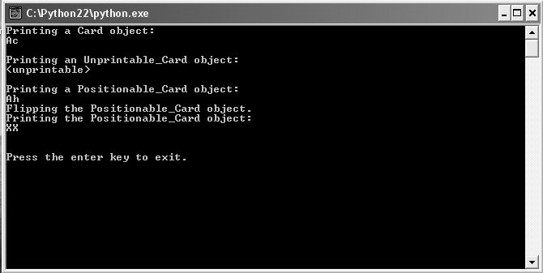
The Playing Cards 3.0 Program
Figure 9.6: Sample run of the Playing Cards program
By overriding __str__(), objects of derived classes print differently.
Guide to Programming with Python

Slide 35
Creating a Base Class
(Same as before)
class Card(object):
""" A playing card. """
RANKS = ["A", "2", "3", "4", "5", "6", "7",
"8", "9", "10", "J", "Q", "K"]
SUITS = ["c", "d", "h", "s"]
def __init__(self, rank, suit):
self.rank = rank
self.suit = suit
def __str__(self):
reply = self.rank + self.suit
return reply
Guide to Programming with Python

Slide 36
Overriding Base Class Methods
class Unprintable_Card(Card):
....
def __str__(self):
return "<unprintable>"
Unprintable_Card
  Inherits all methods of Card
  Overrides inherited method __str__()
  Printed object displayed as <unprintable>
A derived class has no effect on a base class
Guide to Programming with Python

Slide 37
Invoking Base Class Methods
In overridden method, can incorporate inherited method’s functionality
Suppose we want to have a card that can be face up or face down…
class Positionable_Card(Card):
def __init__(self, rank, suit, face_up = True):
super(Positionable_Card, self).__init__(rank, suit)
self.is_face_up = face_up
Superclass: Another name for a base class
Card is the superclass of Positionable_Card
Guide to Programming with Python

Slide 38
Invoking Base Class Methods (continued)
super(Positionable_Card, self).__init__(rank, suit)
Incorporate inherited method’s functionality by calling super()
Positionable_Card constructor invokes Card constructor and creates new attribute
super() lets you invoke the method of a superclass
  First argument is the base class, Positionable_Card
  Second is a reference to the object itself, self
  Last is the superclass method you want to call with its parameters, __init__(rank, suit)
Guide to Programming with Python

Slide 39
Invoking Base Class Methods (continued)
class Positionable_Card(Card):
def __str__(self):
if self.is_face_up:
reply = super(Positionable_Card, self).__str__()
else:
reply = "XX"
return rep
def flip(self):
self.is_face_up = not self.is_face_up
__str__() invokes superclass __str__() method if card is face up; otherwise, returns "XX"
Guide to Programming with Python

Slide 40
Using the Derived Classes
card1 = Card("A", "c")
card2 = Unprintable_Card("A", "d")
card3 = Positionable_Card("A", "h")
print card1 # Ac
print card2 # <unprintable>
print card3 # Ah
card3.flip()
print card3 # XX
playing_cards3.py
Guide to Programming with Python

Slide 41
Understanding Polymorphism
Polymorphism: Aspect of object-oriented programming that allows you to send same message to objects of different classes, related by inheritance, and achieve different but appropriate results for each object
When you invoke __str__() method of Unprintable_Card object, you get different result than when you invoke the __str__() method of a Card object
Guide to Programming with Python

Slide 42
Creating Modules
Create, use, and even share your own modules
Reuse code
  Could reuse the Card, Hand, and Deck classes for different card games
Manage large projects
  Professional projects can be hundreds of thousands of lines long
  Would be nearly impossible to maintain in one file
Guide to Programming with Python

Slide 43
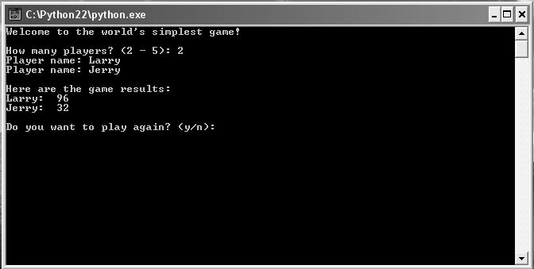
The Simple Game Program
Figure 9.7: Sample run of the Simple Game program
Program uses functions and class from programmer-created module.
Guide to Programming with Python

Slide 44
Writing Modules
Write module as a collection of related programming components, like functions and classes, in single file
File is just Python file with extension .py
Module imported using filename, just like built-in modules
Guide to Programming with Python

Slide 45
Writing Modules (continued)
games module is file games.py
class Player(object):
""" A player for a game. """
def __init__(self, name, score = 0):
self.name = name
self.score = score
def __str__(self):
reply = self.name + ":\t" + str(self.score)
return reply
Guide to Programming with Python

Slide 46
Writing Modules (continued)
def ask_yes_no(question):
"""Ask a yes or no question."""
response = None
while response not in ("y", "n"):
response = raw_input(question).lower()
return response
def ask_number(question, low, high):
"""Ask for a number within a range."""
response = None
while response not in range(low, high):
response = int(raw_input(question))
return response
Guide to Programming with Python

Slide 47
Writing Modules (continued)
if __name__ == "__main__":
print "You ran module but must 'import' it."
raw_input("\n\nPress the enter key to exit.")
__name__ == "__main__" is true if file is run directly; is false if the file is imported as module
If games.py run directly, message displayed that the file is meant to be imported
games.py
Guide to Programming with Python

Slide 48
Importing Modules
import games, random
Import programmer-created module the same way you import a built-in module
Guide to Programming with Python

Slide 49
Using Imported Functions and Classes
num = games.ask_number(question = "How many?",
low = 2, high = 5)
...
player = games.Player(name, score)
...
again = games.ask_yes_no("Play again? (y/n): ")
Use imported programmer-created modules the same way as you use imported built-in modules
simple_game.py
Guide to Programming with Python

Slide 50
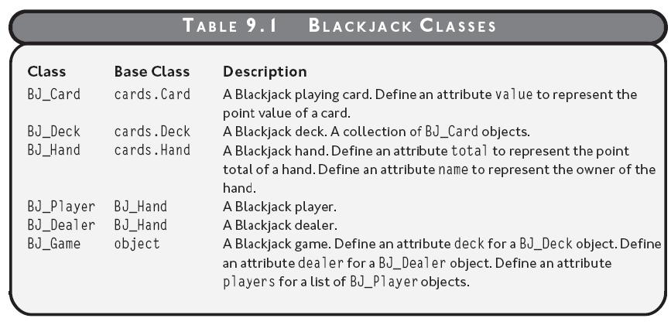
The Blackjack Game - Classes
blackjack.py
(just play)
Table 9.1: Blackjack classes
Guide to Programming with Python

Slide 51
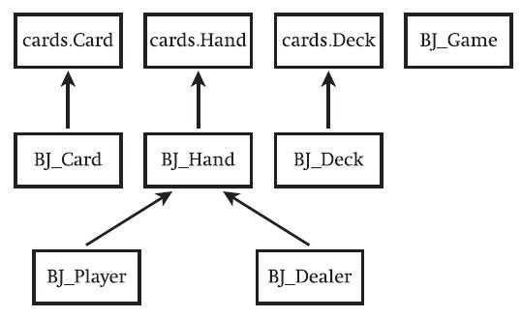
The Blackjack Game – Class Hierarchy
object
Figure 9.8: Blackjack classes
Inheritance hierarchy of classes for the Blackjack game
Guide to Programming with Python

Slide 52
The Blackjack Game - Pseudocode
Deal each player and dealer initial two cards
For each player
While the player asks for a hit and the player is not busted
Deal the player an additional card
If there are no players still playing
Show the dealer’s two cards
Otherwise
While the dealer must hit and the dealer is not busted
Deal the dealer an additional card
If the dealer is busted
For each player who is still playing
The player wins
Guide to Programming with Python

Slide 53
The Blackjack Game – Pseudocode (continued)
Otherwise
For each player who is still playing
If the player’s total is greater than the dealer’s total
The player wins
Otherwise, if the player’s total is less than the dealer’s total
The player loses
Otherwise
The player pushes
cards.py
blackjack.py
Guide to Programming with Python

Slide 54
Summary
In object-oriented programming, objects can send messages to each other by invoking each other’s methods
Objects can be composed of other objects or have collections of objects
Inheritance is an aspect of object-oriented programming that allows a new class to be based on an existing one where the new class automatically gets (or inherits) all of the methods and attributes of the existing one
Guide to Programming with Python

Slide 55
Summary (continued)
Inheritance can be used to create a more specialized version of an existing class
A base class is a class upon which another is based; it is inherited from by this other class (the derived class)
A derived class is a class that is based upon another class; it inherits from this other class (a base class)
Superclass is another name for base class
Guide to Programming with Python

Slide 56
Summary (continued)
A derived class can define new methods and attributes in addition to the ones that it inherits
To override an inherited method is to redefine how the method of a base class works in a derived class
When overriding a method, the new definition can have completely different functionality than the original definition or the new definition can incorporate the functionality of the original
Guide to Programming with Python

Slide 57
Summary (continued)
The super() function allows you to invoke the method of a superclass
Polymorphism is an aspect of object-oriented programming that allows you to send the same message to objects of different classes, related by inheritance, and achieve different but appropriate results for each object
You can write, import, and even share your own modules
Guide to Programming with Python

Slide 58
Summary (continued)
You write a module as a collection of related programming components, like functions and classes, in a single Python file
Programmer-created modules can be imported the same way that built-in modules are, with an import statement
You test to see if __name__ is equal to "__main__" to make a module identify itself as such
Guide to Programming with Python

